Slide 1
Risk-Based Collision Avoidance in Autonomous Vehicles
Christopher Hay ‘17
Advisor: Thomas Funkhouser

Slide 2
Motivation
Motor Vehicle Fatalities
In the U.S., roughly 31,000 people die in road crashes every year [1]
2.5 million are injured [1]
Autonomous vehicles are on the rise, giving safety features greater potential
However, proprietary control systems in autonomous vehicles

Slide 3
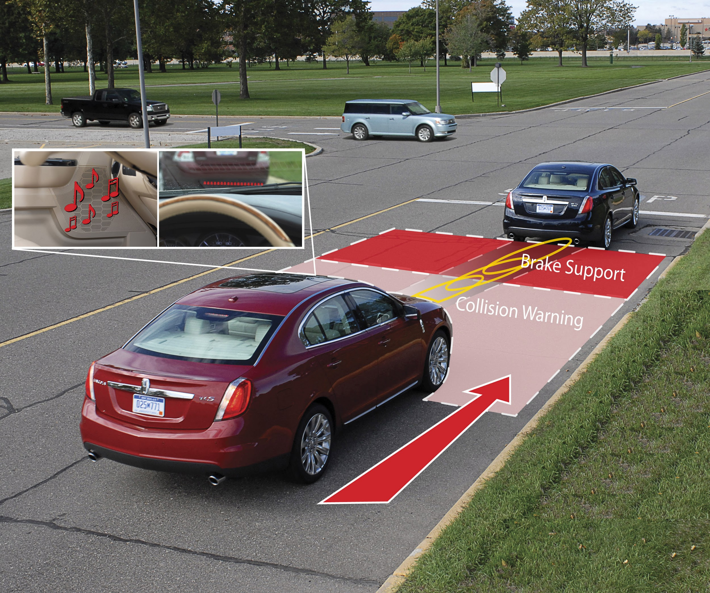
Related Work
Safety Mechanisms
Forward braking assist
Forward steering assist
DeepDriving

Slide 4
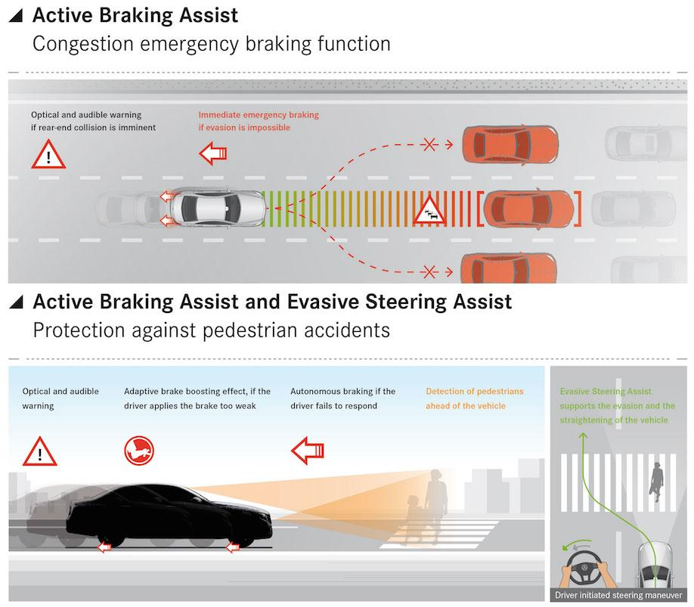
Related Work
Safety Mechanisms
Forward braking assist
Forward steering assist
DeepDriving

Slide 5
Related Work
Safety Mechanisms
Forward braking assist
Forward steering assist
DeepDriving
Image-based
Gives localization and distance to vehicles
Has a controller, but it doesn’t handle extreme situations well
Direct perception algorithm

Slide 6
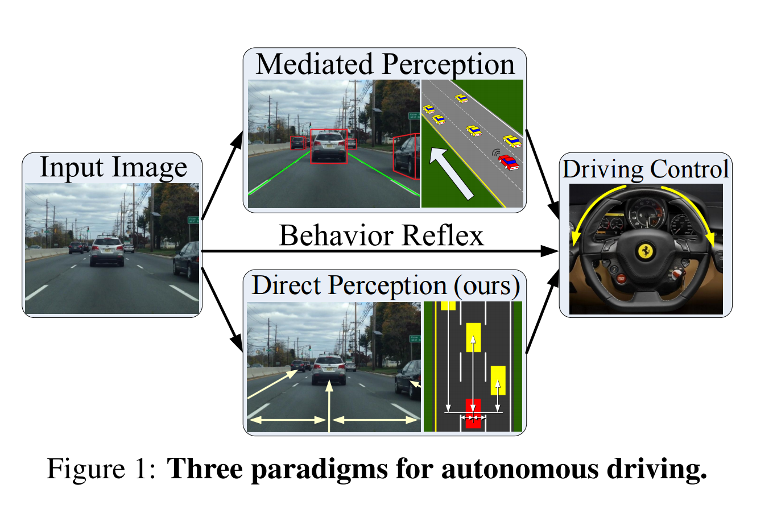
Related Work
Safety Mechanisms
Forward braking assist
Forward steering assist
DeepDriving

Slide 7
Goal
Create a collision avoidance controller for DeepDriving that prevents more accidents than its default controller as well as current forward assist systems.

Slide 8
Key Insight
Semi-Realistic Simulation + Direct Perception
Direct perception algorithms allow simulation performance to more accurately reflect real world performance.
So, only need a roughly accurate physics engine

Slide 9
Approach
Generate Training Data
Risk Estimation
Minimize Risk

Slide 10
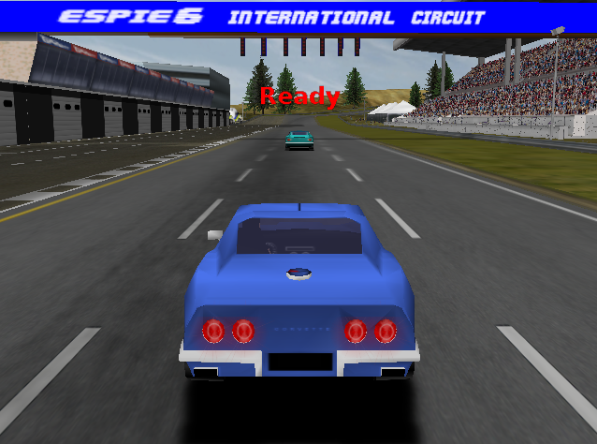
Implementation
Generate Data
Risk Estimation
Minimize Risk

Slide 11
Implementation
Generate Data
Risk Estimation
Minimize Risk
Full knowledge of ground truths
True speed of both cars
true distance
Predict crash
Predict going offroad
Features
Starting speed of our car
Starting distance between cars
Control behavior used

Slide 12
Implementation
Generate Data
Risk Estimation
Minimize Risk
NO knowledge of ground truths
Speed of our car
Distance to other cars
Estimated by DeepDriving algorithm
Estimate risk for every possible action/control
Find the probability of collision or going offroad for every permutation of control:
Every permutation of steering, brakes, and desired lane: 144 behaviors

Slide 13
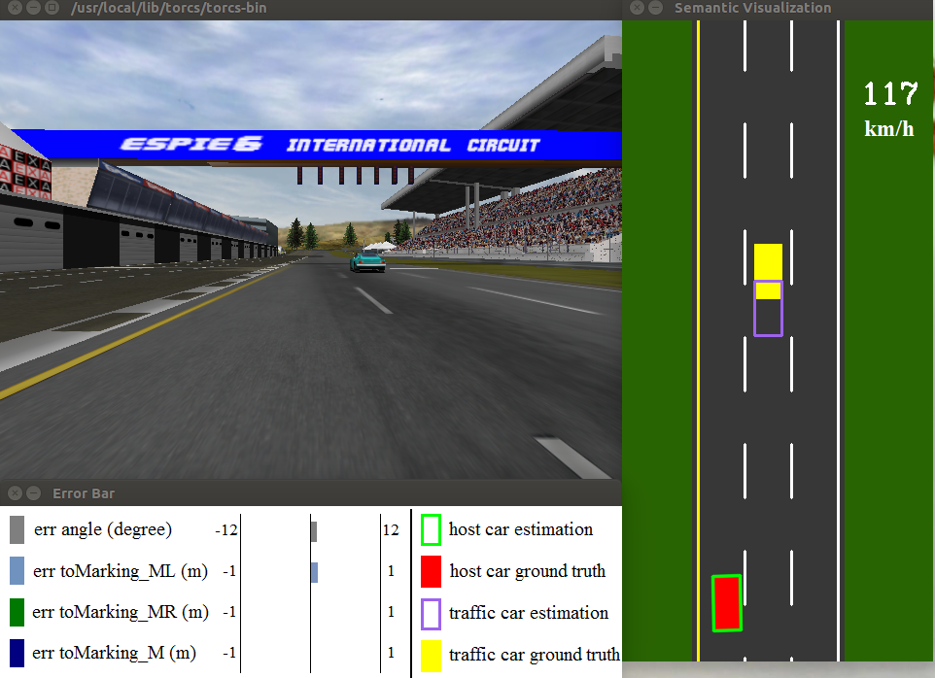
Implementation
Generate Data
Risk Estimation
Minimize Risk

Slide 14
Implementation
Generate Data
Risk Estimation
Minimize Risk
Choose the action with the lowest average probability of collision/offroad
Using :
Random Forest Classifier
AdaBoost Classifier
Logistic Regression

Slide 15
Training Results
Brake assist and steering assist
Better than nothing
But no one-size-fits all solution
Always a trade-off between reducing collisions and going offroad

Slide 16
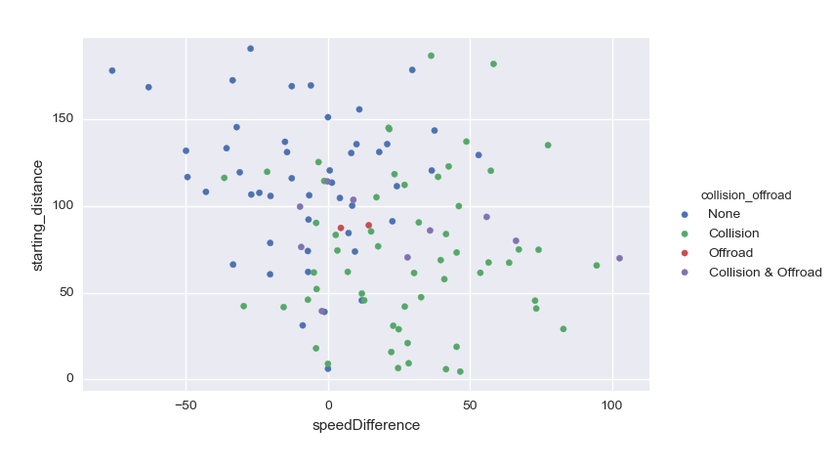
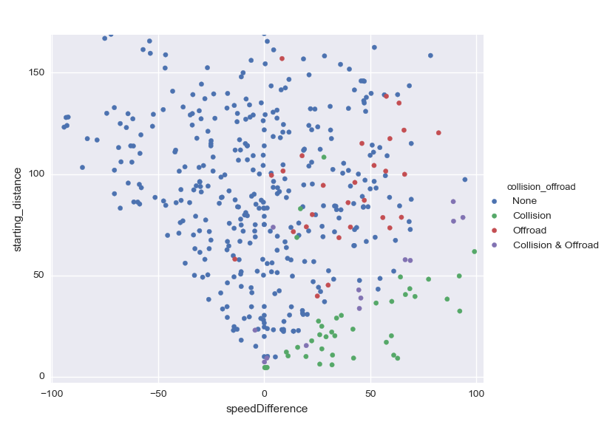
Training Results
No Brakes, No Steering
80% Brakes, 40% Steering

Slide 17
Training Results
Most accurate classification:
Random Forest Classifier
Neural Net
Most accurate probability modeling:
Logistic Regression Classifier
Single obstacle and three obstacle simulations have comparable results

Slide 18
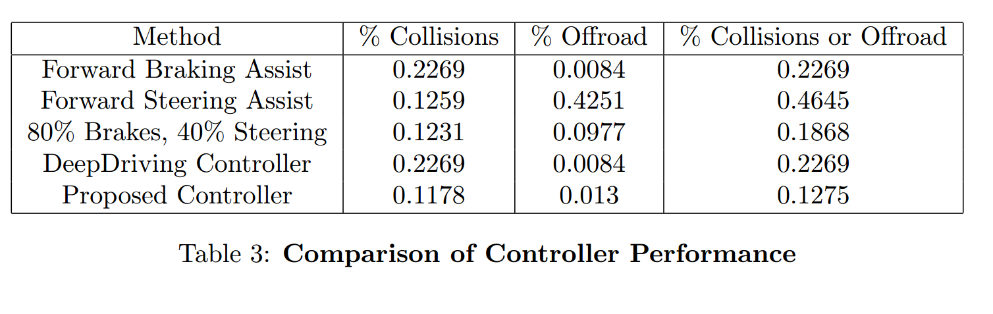
Evaluation

Slide 19
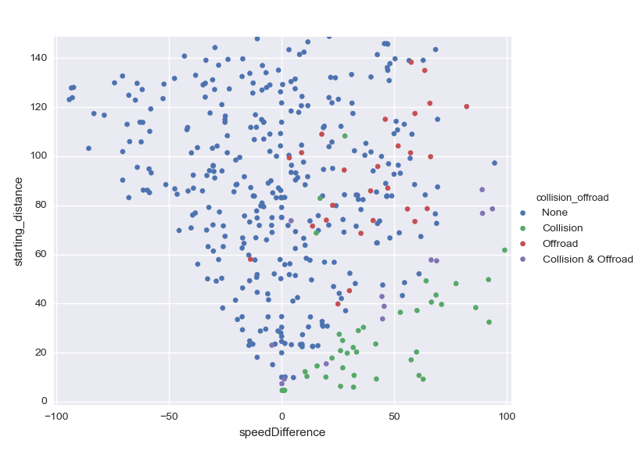
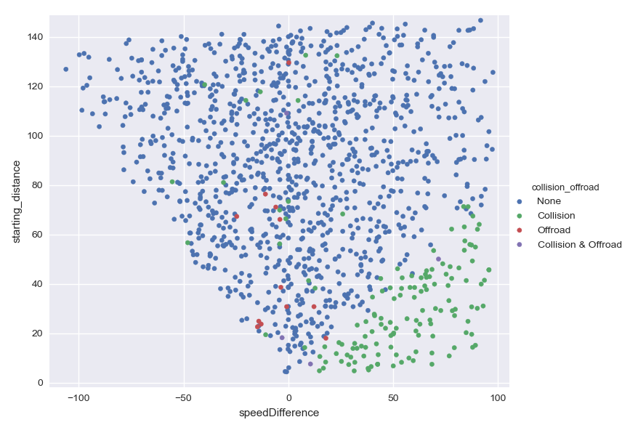
Evaluation
80% Brakes, 40% Steering
Proposed Controller

Slide 20
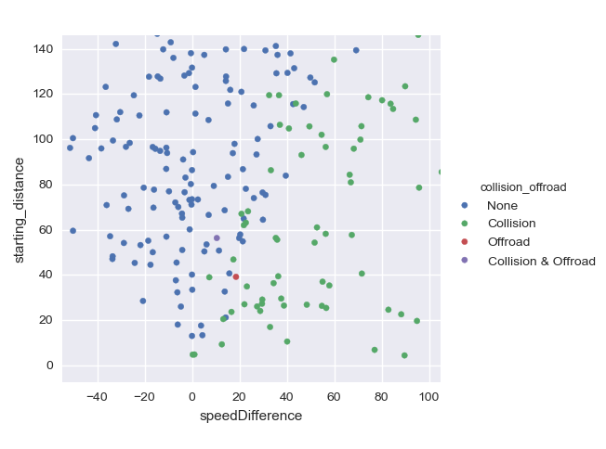
Evaluation
DeepDriving Controller
Proposed Controller

Slide 21
Conclusion
Brake assist and steering assist
Do not perform well individually
A couple specific combinations do better than DeepDriving
Direct perception + simulation + machine learning
Much better!

Slide 22
References
[1] Association for Safe International Road Travel. Road crash statistics.

Slide 23
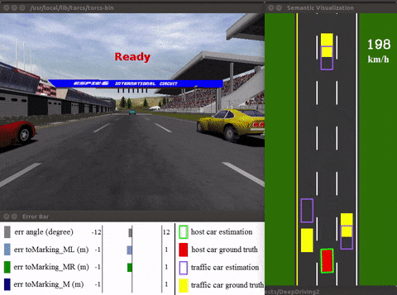
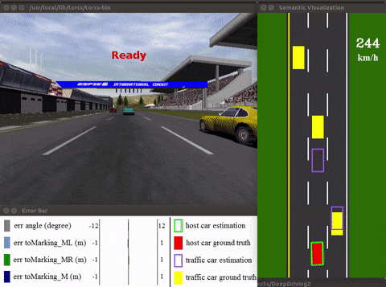
Comparison
DeepDriving Controller
Proposed Controller

Slide 24
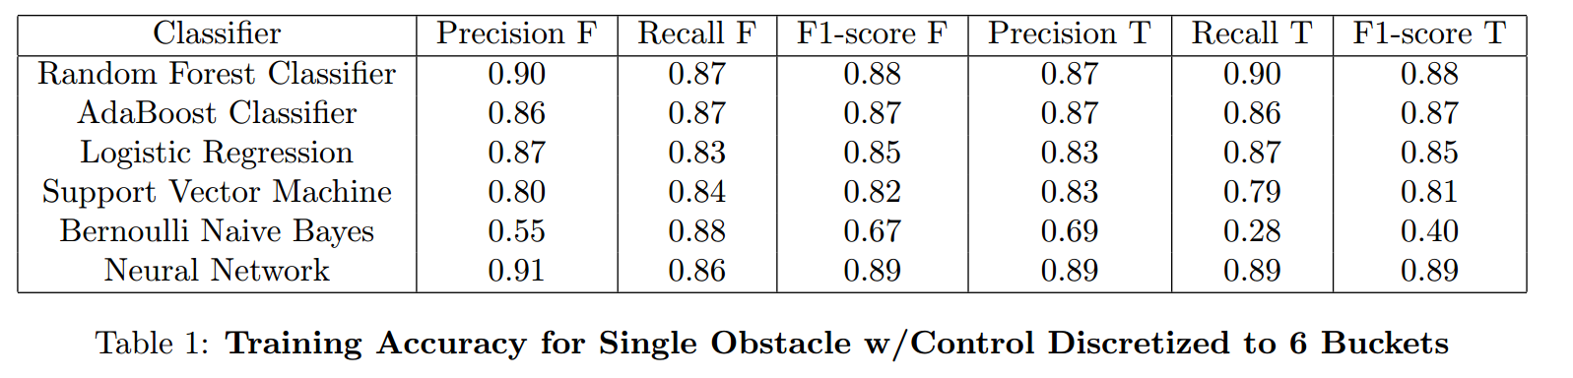
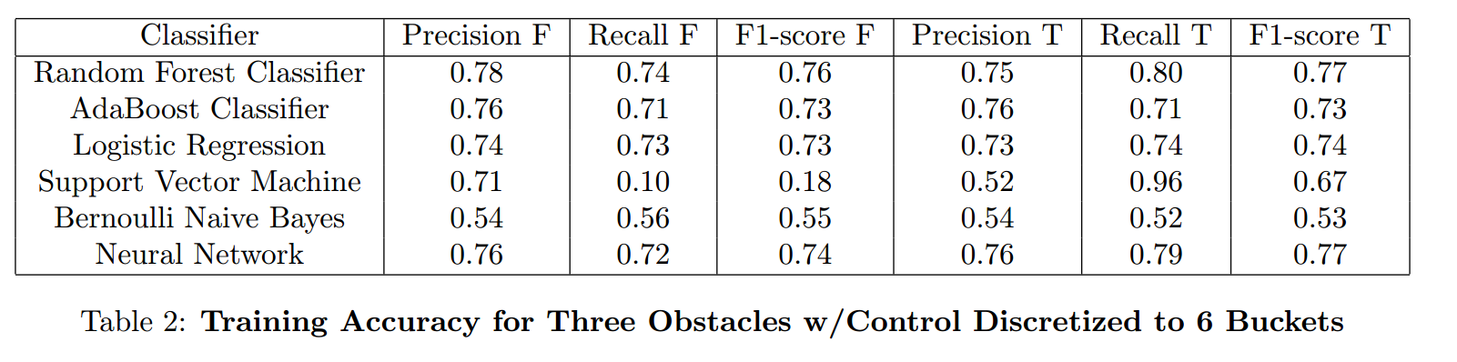
Results
Training Results
Evaluation
Only slight decrease in performance for most

Slide 25
